Slide 1
Python Bootcamp Toolboxes
PhD Bruno C. Quint
bquint@ctio.noao.edu
Resident Astronomer at SOAR Telescope
https://github.com/b1quint/PythonBootcamp2017

Slide 2
Table of Contents
iPython
Jupyter
PyCharm

Slide 3
Python Vs iPython

Slide 4
Python Vs iPython

Slide 5
Python Vs iPython

Slide 6
Python Vs iPython

Slide 7
Python Vs iPython

Slide 8
Python Vs iPython
Colors!!

Slide 9
Python Vs iPython
Tab Completion
Tab pressed 3x

Slide 10
Python Vs iPython
Tab Completion
Tab pressed 3x

Slide 11
Python Vs iPython
Tab Completion
Tab pressed 3x
:-(

Slide 12
Python Vs iPython
Tab Completion
:-)
Tab pressed 1x

Slide 13
Python Vs iPython
Tab Completion

Slide 14
Python Vs iPython
Tab Completion

Slide 15
Python Vs iPython
Help with (i)Python

Slide 16
Python Vs iPython
Help with Python

Slide 17
Python Vs iPython
Help with iPython

Slide 18
Python Vs iPython
Help with iPython

Slide 19
Python Vs iPython
Magic Functions

Slide 20
Jupyter / iPython Notebook

Slide 21
Jupyter / iPython Notebook

Slide 22
Jupyter / iPython Notebook

Slide 23
Jupyter / iPython Notebook

Slide 24
Jupyter / iPython Notebook

Slide 25
Jupyter / iPython Notebook
<ENTER>: New line
<SHIFT> + <ENTER>: Execute cell

Slide 26
Jupyter / iPython Notebook

Slide 27
Jupyter / iPython Notebook

Slide 28
Jupyter / iPython Notebook
Command Mode

Slide 29
Jupyter / iPython Notebook
Edit Mode

Slide 30
Jupyter / iPython Notebook

Slide 31
Jupyter / iPython Notebook
<m> in _command mode_: swicth to Markdown edition

Slide 32
Jupyter / iPython Notebook

Slide 33
Jupyter / iPython Notebook

Slide 34
Jupyter / iPython Notebook

Slide 35
Jupyter / iPython Notebook

Slide 36
Jupyter / iPython Notebook

Slide 37
Jupyter / iPython Notebook

Slide 38
Jupyter / iPython Notebook

Slide 39
Jupyter / iPython Notebook

Slide 40
PyCharm – Not Used

Slide 41
PyCharm – Tab

Slide 42
PyCharm – See parameters

Slide 43
PyCharm

Slide 44
PyCharm – Auto-complete

Slide 45
PyCharm – Auto-complete

Slide 46
PyCharm – Quick Help

Slide 47
PyCharm – Quick Help

Slide 48
PyCharm - Run

Slide 49
PyCharm - Debug

Slide 50
PyCharm – PEP-8

Slide 51
PyCharm – PEP-8

Slide 52
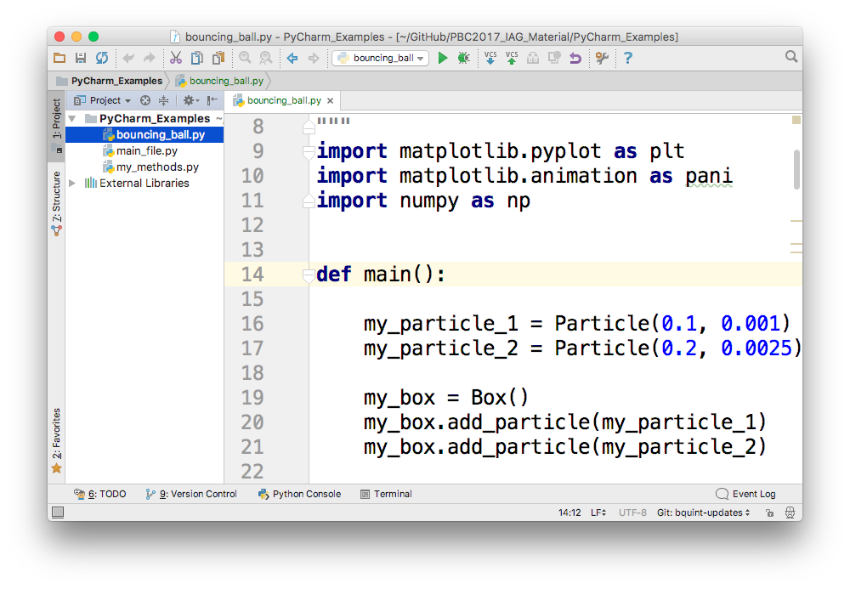
PyCharm - Structure

Slide 53
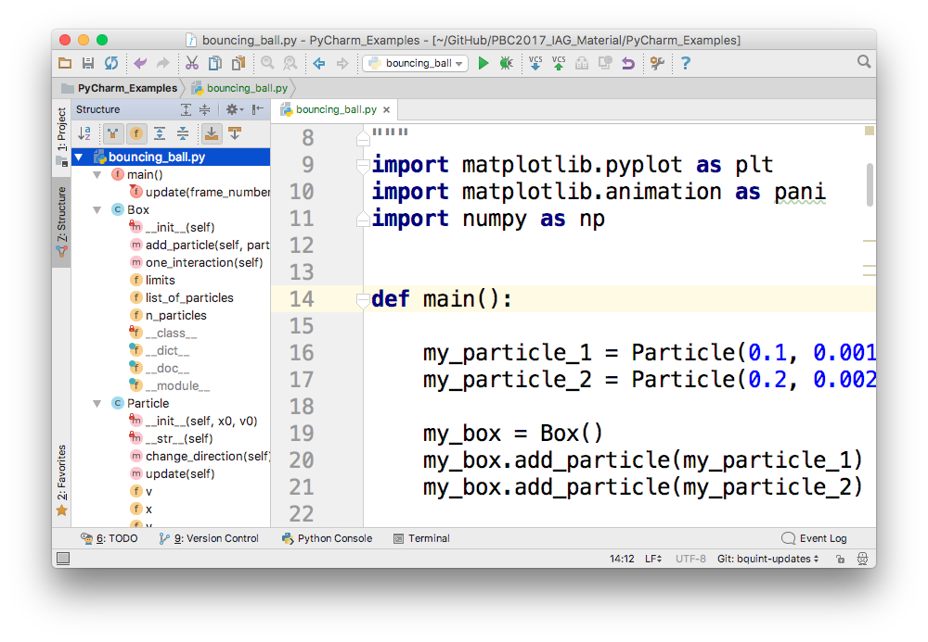
PyCharm - Structure

Slide 54
PyCharm – Version Control (Git)

Slide 55
PyCharm – Version Control (Git)

Slide 56
PyCharm – Version Control (Git)

Slide 57
PyCharm – Version Control (Git)

Slide 58
PyCharm – Version Control (Git)

Slide 59
PyCharm – Version Control (Git)

Slide 60
Questions?

